Slide 1

PloobsEngine Post Mortem

Slide 2
Agenda
Game Engine !!!???
Overview
PloobsEngine
Experiências Acumuladas

Slide 3
Apresentacao
Thiago Dias Pastor
Criador e Desenvolvedor Ploobs
Engenheiro Da Computacao pela Poli-Usp
Bruno Duarte Correa
Criador e Desenvolvedor Ploobs
Engenheiro Da Computacao pela Poli-Usp

Slide 4









Game Engine
Renderer (2D or 3D)
Detector de Colisão
Scripting
Som/Video
Animação
Shading/Iluminação
Networking
Física
Inteligência Artificial
Level Editor
Custom Tools

Slide 5
MÓDULOS BÁSICOS
DE
UMA GAME ENGINE

Slide 6
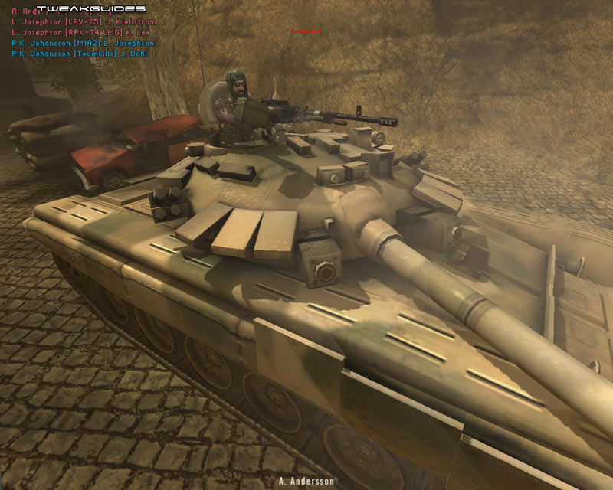
Render Engine
Controlar a Geração de imagens 2D em tempo real a partir das informações do Grafo de Cena.
Objetos
Partículas
Efeitos Especiais ...
Interage diretamente com a GPU.
Geralmente feito em OpenGL ou DirectX

Slide 7
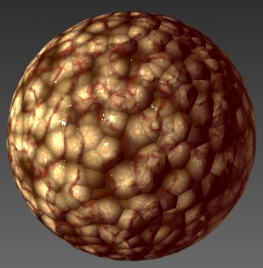
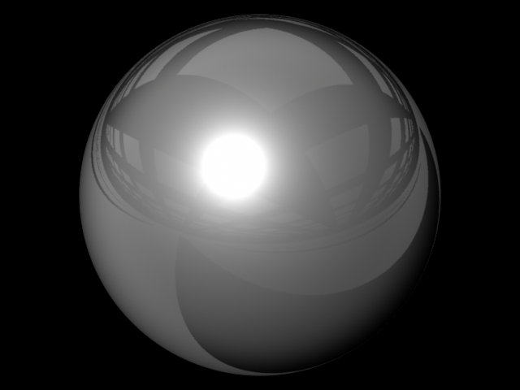
Shading/Lighting Engine
Trabalha com a Render Engine
Calcula Iluminação:
Point, Direction, Spot ...
Phong Shading
Calcula efeitos especiais:
Sombras
Shadow Mapping
CSM – VSM ...
Normal Maps
Partículas
Outros...
Aplicado aos objetos pelo Renderizador a partir de informações do Grafo de cena

Slide 8
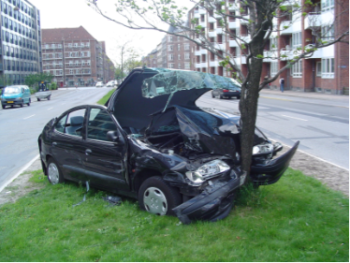
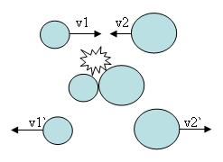
Collision Detection Engine
Intersecção entre sólidos
Esferas
Planos
Cilindros
Poligonos
Triangle Meshes
Characters
Custom Objects
Resposta à Colisão
Eventos
Física Newtoniana
Alta complexidade Computacional
Divisão Espacial
Octree
QuadTree

Slide 9
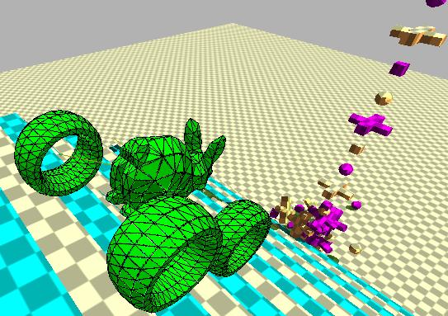
Physics Engine
Manipula o comportamento de objetos baseado nas colisões.
Determinístico VS Comportamento Estocástico
Integrado com Sistema de Colisão
CPU / GPU
Modelos de simulação.
Dinâmica de Corpo Rígido.
Soft Body Physics
Dinâmica de fluídos
Carros
Personagens
Complexo
Raycast + Dinámica

Slide 10

Scripting Engine
Geralmente utiliza-se linguagens interpretadas (Python, Lua, etc.)
Flexibilidade e Simplicidade
Alterações em Tempo Real
Não modifica código algum da engine
Específico de cada Jogo
Gama de Utilização
Menus
Criação de Objetos
Lógica do jogo
Resposta à eventos
Atribuir Comportamento

Slide 11
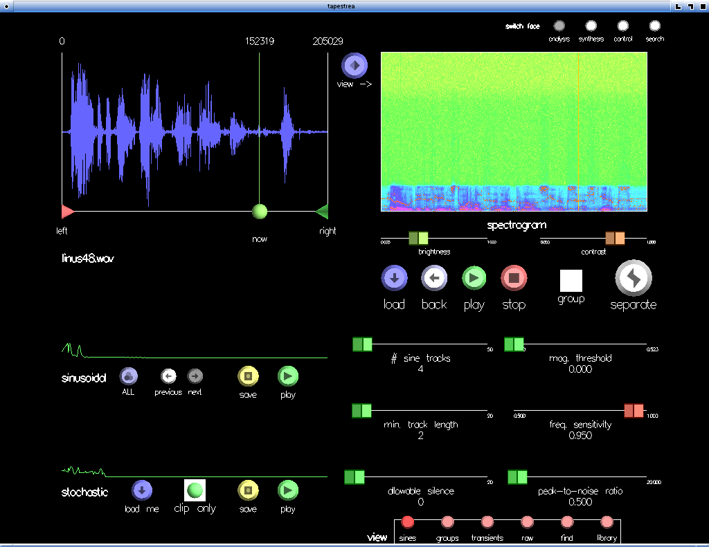
Sound/Video Engine
Construída em cima de APIs como OpenaAl ou DirectSound.
Video
Cut-scenes, ou pedaços de objetos no jogo, como uma TV, cameras estáticas.
Sound
Efeitos 2D, BackGround
Som 3d
Efeito Dopler
Surround.

Slide 12
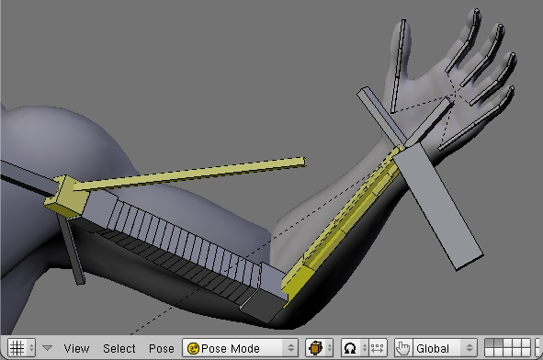
Animation Engine
Representaçao:
Bone Animation
KeyFrame Animation
Importar Informações de Animação (Pose, Bones, keyframes...)
Manipula animações de objetos no Grafo de Cena.
Interpola animações (Keyframes ou Bones)

Slide 13

Networking Engine
Manipula comunicação entre computadores.
Peer to Peer / Distributed
Client to Server
UDP
TCP
Interpolação
Segurança
Identificação
Criptografia
Compactação

Slide 14

Artificial Intelligence Engine
Oferece Primitivas para o Programador criar os comportamentos avançados
Técnicas Clássicas
A * (PathFinding)
Hierarchical State Machines
Steering Behaviors
Redes Neurais
Algorítimos Genéticos
Min/Max
Controla interação entre objetos.
Estímulos
Necessidades
Desejos
Group Behavior

Slide 15
Gerenciamento
de
Assets

Slide 16
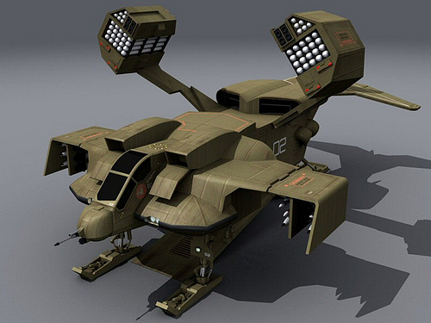
Assets
Insumos para Engine.
Qualquer coisa no jogo, menos código.
Modelos
Bones
Texturas
Sons
Videos
Animações
Logos
Scripts
Arquivos de
Configuração

Slide 17
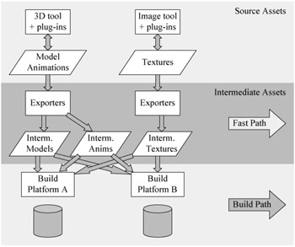
Assets

Slide 18
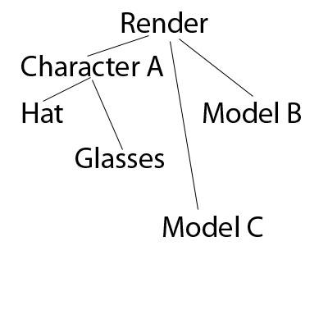
Grafo de Cena
Gerenciamento da cena
Logicamente
Alocação
Espacialmente
Posição Física
Graph Structure
Não hierarquicamente
Tree Structure
Hierarquicamente
Culling

Slide 19
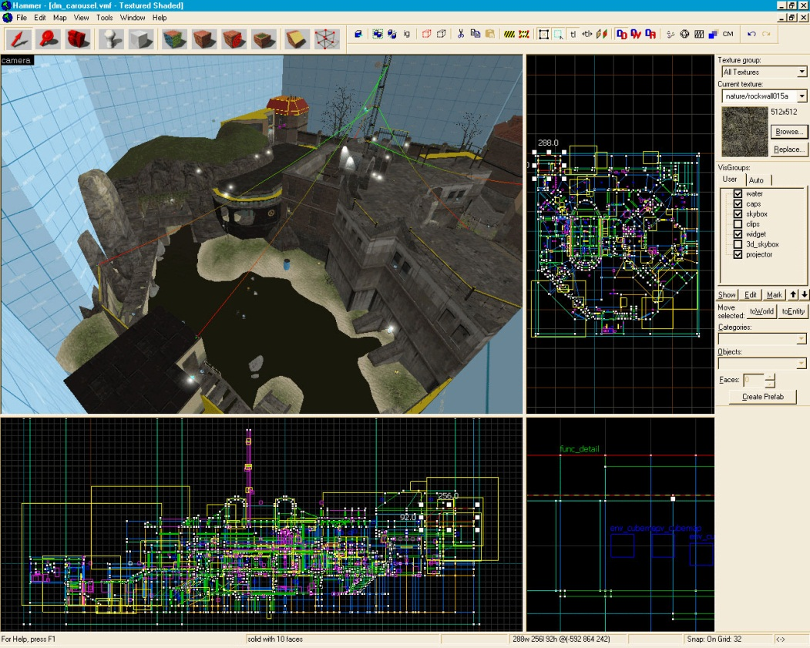
Level Editor
Interface Engine <-> Usuário
WYSIWYG
Importar Assets
Posicionar Assets
Atribuir comportamento
Eventos
Scripts
Objetos Estáticos
Arquitetura
Data Driven Design
Component Based

Slide 20
Custom Tools
Quest Editor
Dialogue System
Multiplayer Support (Chat, Rooms)
Ranking Systems
Faz parte da Engine ??!!

Slide 21
Engine != Jogo ??!!
Palestra Damian Isla (SBGames 2011)
Engine = Jogo??!!
Engines Off the Shelf.
Porque não se aventurar em fazer algo “do zero” ?
Implicações
Processo de desenvolvimento diferenciado
Perfil da Equipe de desenvolvimento
Ordem
Especialização
Reutilização no nivel do Middleware
Altíssima Customização
Content Oriented Design
Basear o desenvolvimento na flexibilidade com o designer.

Slide 22
Programador Engine != Programador GamePlay
Conhecimentos Diferenciados
Matemática
Física
Computacao gráfica
Motivações Diferentes
Teste !!!
Projetos com Durações diferentes
PloobsEngine (3 anos =P)
Perfis Complementares

Slide 23
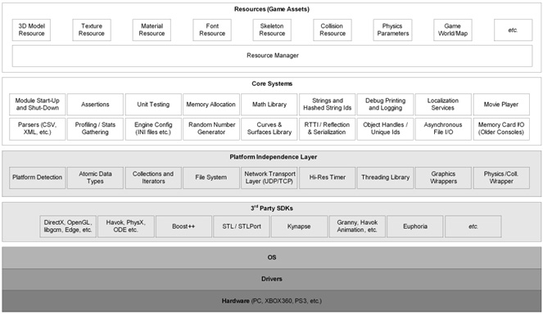
Game Engine Modules I

Slide 24
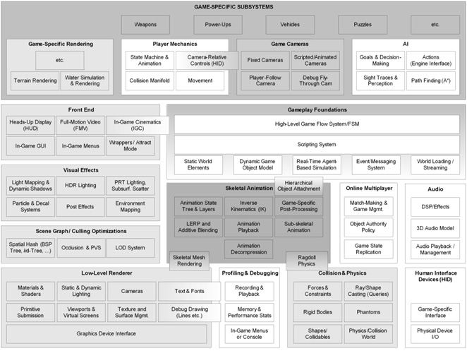
Game Engine Modules II

Slide 25
Literatura

Slide 26
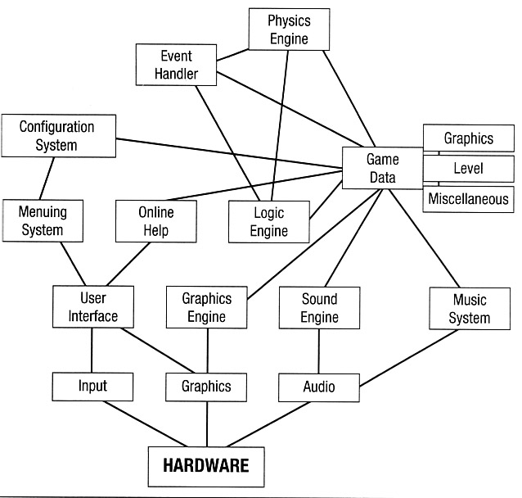
Literatura
Muitos livros sobre Computação Gráfica
Exemplos Didáticos
Muitos livros sobre Técnicas e Shaders
Exemplos Avançados
Transição Difícil
Pouca informação sobre Arquitetura e Design de Engines.
Aproach clássico Monolítico;
Didático
Inadequada para um jogo real.
Alto Acoplamento
Separação da lógica no nível de classes não é suficiente para projetos com milhões de linhas de código.

Slide 27
Literatura
Problemas Com o Design Monolítico “Acadêmico”:
Portabilidade
Manutenção e Extensão
Mudanças alteram o sistema inteiro
Presença da “Entidade” !!!!
Reusabilidade
Alto acoplamento
Sugestão :
Game Programming Gems
AI Game Programming Wisdom
Real Time Rendering
Pedaços de código que oferecem soluções elegantes e independente de arquiteturas para problemas clássicos.
Exemplos REAIS !!!!
Utilizados em grandes projetos de jogos.

Slide 28
The First and Only Real Attempt at Game Architecture
Andrew Rollings’s and Dave Morris’s Game Architecture and Design is the only book on the market right now that discusses games in terms of their architecture.
The book proposes to design around the quote by Dave Roderick, “A game is just a real-time database with a pretty front end.” While that statement might seem correct, this thesis proposes the slightly modified statement – games are a system of systems operating on a database with a pretty front end.
The book gives an excellent introduction into the roots of game development and why architecture and software engineering practices have never really taken hold in this area of software.
The authors attribute the lack of engineering practices to the origins and attitudes of game developers. Games originated from solo programmers who hand coded every line, and that solo attitude still prevails in the industry today. Not using third party components is still a point of pride for many developers.

Slide 29
Basic Game Architecture

Slide 30
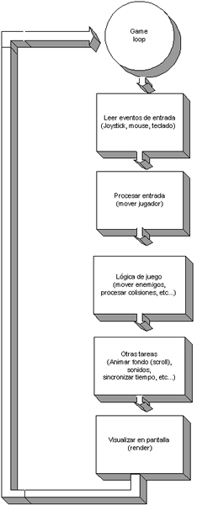
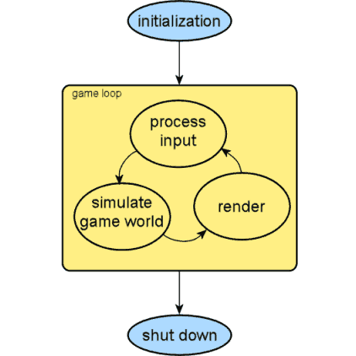
Game Loop

Slide 31
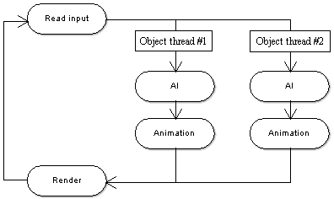
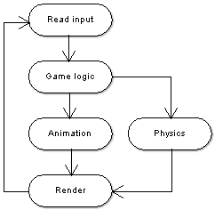
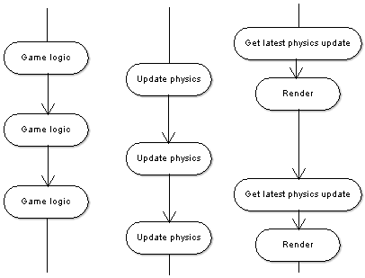
MultiThreading Game Loop

Slide 32
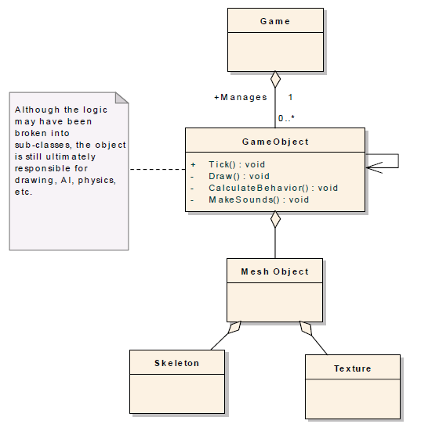
Typical Game Object

Slide 33
Características de uma boa Engine
Modularidade
Separando o projeto em módulos completamente encapsulados permitindo a cada um ser independentemente testado, modificado ou subistituido sem impactos para o resto do sistema.
Reusabilidade
Reinventar a roda toda vez não faz sentido. Módulos devem ser desenhados para ser extensíveis e portaveis para poderem ser plugados em outros projetos.
Robustês
Um alto nível de confiabilidade é melhor alcançado com arquiteturas baseadas em módulos livres de interdependências. O objetivo final é uma meta-arquitetura capaz de construir jogos que são sempre funcionais em circunstâncias inesperadas .
Rastreabilidade
The project plan is derived directly from the architecture, yielding a schedule that
allows realistic measurement of progress.

Slide 34
Pensamentos
“Generally though, the concept of a game engine is fairly simple:
it exists to abstract the (sometime platform-dependent) details of doing
common game-related tasks, like rendering, physics, and input, so that
developers (artists, designers, scripters and, yes, even other programmers)
can focus on the details that make their games unique.”
Engine boa é engine que o desenvolvedor nem vê
Ditado popular

Slide 35
APIs and SDKs Two other terms you hear in the game industry that are closely related to game engines are "API" (application programming interface) and "SDK" (software development kit).
APIs are the software interfaces that operating systems, libraries, and services provide so that you can take advantage of their particular features.
An SDK is a collection of libraries, APIs, and tools that are made available for programming those same operating systems and services.
Most game engines provide APIs in their SDKs. The Unreal Engine, for example, provides an interface for programmers to create their games, both through a scripting language called UnrealScript, and through libraries, which are provided to anyone who licenses the engine, and which come in the same package as their other tools, like the editor UnrealEd.

Slide 36
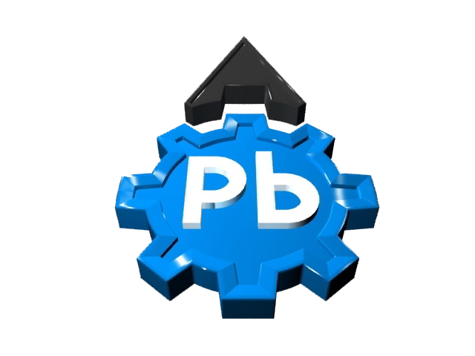
PLOOBS
ENGINE

Slide 37
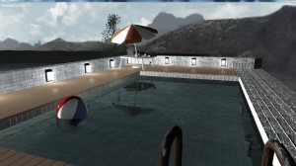
PloobsEngine
PloobsEngine is an opensource engine for creating games and graphics applications developed in:
XNA 4.0,
C# .Net 4.0
HLSL.
It is designed to be simple and easy to use even for those unfamiliar with computer graphics programming.

Slide 38
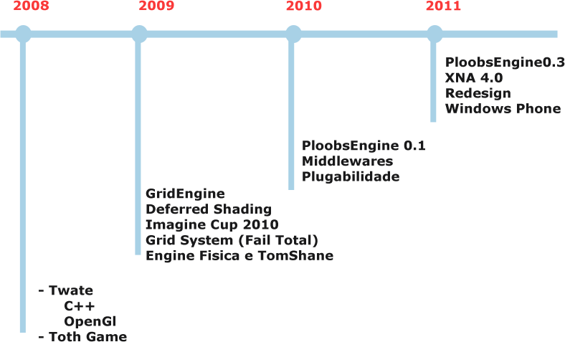
Histórico !!!

Slide 39
Processo De Desenvolvimento
Criar uma Engine ??!!??!!
STOP
Estudo Detalhado
PloobsEngine
Twate Engine
Mais Caos !!!
Redesign
XNA 4.0 + Redesign
C# + XNA !!
CAOS !!!
TCC - Booster
Deferred Shading
Grid Engine
Não é que funciona !!!
Tooth
Imagine Cup 2010

Slide 40

XNA
O que é ?
DirectX 9.c Wrapper
Multiplataforma
Xbox
Windows
Phone7

Slide 41
Features

Slide 42
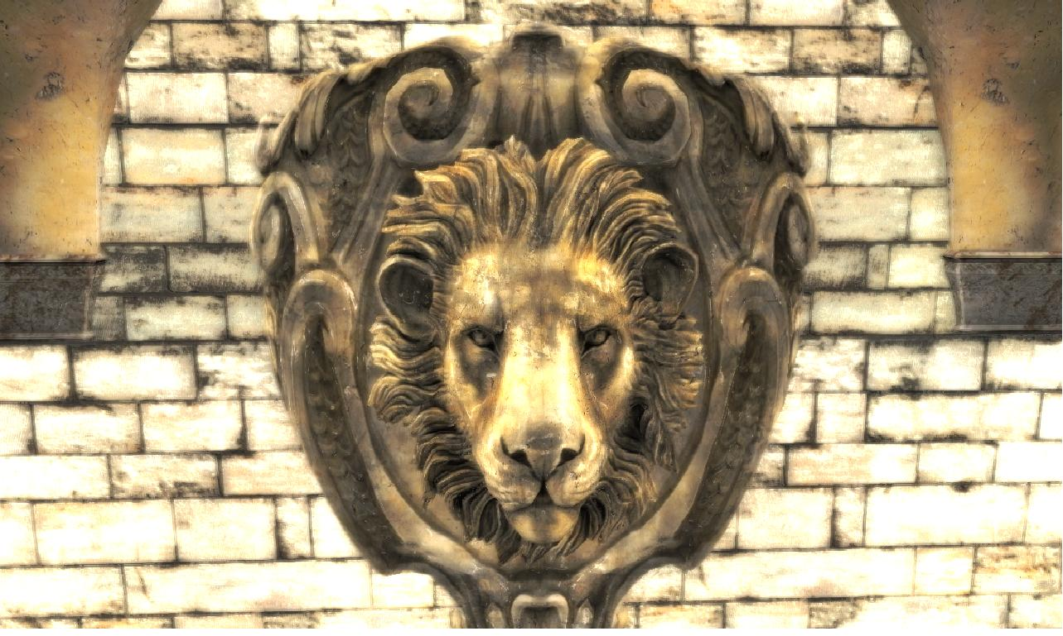
Features
Support for Windows Phone 7 and PC
Deferred Rendering
Bump mapping, Specular mapping, Glow mapping and Parallax mapping
2D and 3D Physical Simulation
2D and 3D Sound
3D Animation by Bones (Bone Animation)
Terrain and Vegetation
Reflection and Refraction in Real Time
Several classical algorithms of Artificial Intelligence
2D and 3D Particle Systems
2D and 3D Dynamic Lights with Shadow
Advanced GUI
Advanced Billboards
Integrated with WPF

Slide 43
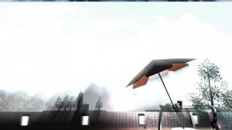
Estruturais
Design Simplista e Flexível
Orientada à Middleware
Expansão
Plugins
Sistema de Componentes
Resource Management System
Sistema de Mensagens
Sistema de Entidades Artemis
Exporter 3DStudio
The Good
The Evil

Slide 44
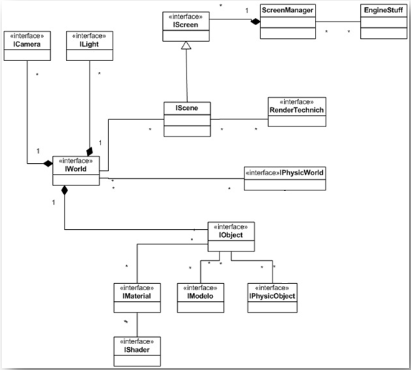
PloobsEngine Architecture

Slide 45

Ferramentas utilizadas
IDE
Visual Studio Ultimate 2010
Nshader
VisualHg
TestDriven
Resharper
License Header Manager
Xbuilder
Nuget
Profiler Shell
GHOST DOC
ILMerge
Controle de Versao
SVN
Mercurial
Branchs
Distribuido

Slide 46
Ferramentas utilizadas
Microsoft Project 2010
Quebrar Tarefas em Subtarefas
Cronograma
Estimativa de Tempo, valor
Acompanhamento
Previsibilidade
Clocking IT (Free)- http://www.clockingit.com/
Tarefas
Bugs
Melhorias
Gmail/Gtalk
Skype
Conferencias

Slide 47
PloobsEngine Middlewares
DPSF Particles – 2D and 3D Particles
Lidgreen Networking – Message Oriented Networking
Bepu Physics – 3D Physic Simulation
Farseer – 2D Physic Simulation
Ltree – Procedural Tree Generation
Neoforce Tomshane - Gui
XNAAnimation – Bone Animation
OpenSteer – Steer Behaviors System
Artemis – Entity System Framework
Gamma Correction Decoder – Gamma Correction Pre Processing

Slide 48

Dificuldades Encontradas
“E agora quem poderá me ajudar“
Comunidade nacional ???
Inexperiência
BUGS ??!!!
Filosofia “Vai que dá” …
Reinventar varias vezes a mesma roda
Nao ouvir o que os outros falam
Pre-Analise
Engenharia de Software
Generalizacao Vs Especializacao
Design Expansivel
Falta de processos
Reter Conhecimento
Retrabalho
Confusão
Bugs …
Sub-utilizacao de ferramentas
Visual Studio Ultimate
Controle de Versoes
Falta de Conhecimento
Técnico
Gerencial

Slide 49
Desafios Atuais
Level Editor
Formação de Time
Começam e Desistem
Mais de 100 emails -> 2 participantes fixos
Falta de Motivação
“Oba !!! Oba !!!”
Falta de Conhecimento
Distância Física
SP – Sao José dos Campos - Roraima – Mogi Das Cruzes
Manutenção
Codigo Grande
Modulos Antigos
Muitos Módulos
Muitas Idéias e pouco TEMPO !!!

Slide 50
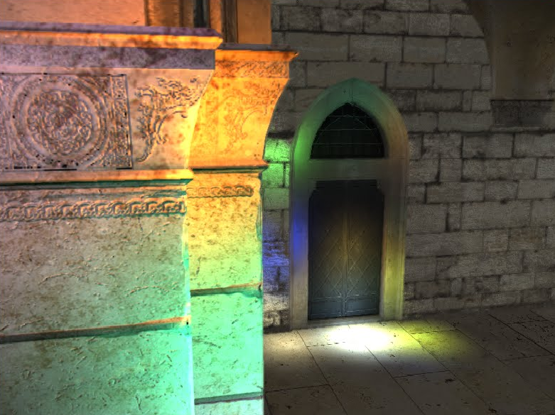
RoadMap
Release 0.4
Testes
Documentação
PloobsEditor
WYSIWYG
Integração com Linguagem de Script
Lua ( Xbox ?? WP7 ?? )
Content Based Game Engine
Networking
P2P
Chat
Rooms …
Demos
Extendendo a Engine
Features Avançadas
Combinando várias Features
Windows Phone 7 Demos

Slide 51

Porque chegamos
onde chegamos
Objetivos Complementares
Personalidades Complementares
Visões Complementares
Automotivação
Hard Working
95% suor
1% genialidade
4% sorte

Slide 52
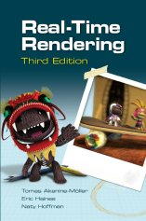




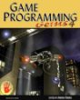




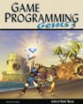
Referencias

Slide 53

Contato
www.ploobs.com.br
contato@ploobs.com.br
Junte-se à nossa Equipe =P

Slide 54
Middleware
Modern games are very rarely works comprised entirely of proprietary, custom code written by in-house developers. The amount of polished functionality required to compete in the games industry is simply an enormous task for a single studio to undertake, and is in a word, unproductive.
The first, most important feature of a middleware package is its integration complexity
Good libraries are highly modular, minimally intrusive, and easy to plug into very different codebases.
A good library should come with reasonable defaults or require very limited configuration before the system is in a testable, working state.

Slide 55
Middleware
Memory Management Consoles, Devices,Pc
Fragmentation
Malloc – Free ???
Mass Storage I/O Access
Loading Assets
File/Memory Abstraction (byte)
FOPEN ???
Logging
Verbose Settings
Debug / Release
Error Handling
Errors are inevitable
Consoles (Heroic Measures)
Stability and Performance Consistency
Main reason why we do not write them =P
Log Problems and keep going
Spikes on CPU Usage
Customer Support
Mail, forum, telephone
Reduce Risk and uncertainty
Easy to maintain
Platform Portability
Is that true ??!!!
Multithreading (Thread safe)
Licensing Requirements
Public domain
The MIT, Zlib, etc., (just credit)
The LGPL license has some stipulations that require distribution of the source of the library
The GPL license and many other similar licenses require complete code release on distribution if you integrate them into your products.
Cost
Service level agreement

Slide 56
The Game Asset Pipeline
The Game Asset Pipeline (a.k.a. the Content Pipeline, and hereafter, simply the Asset Pipeline) is an intricate mechanism that interfaces the artists to the game engine
Game teams have seen their artist/programmer ratio skyrocketing in order to cope with the quantities of high-quality assets on tight schedules
The asset pipeline is the path that all the game assets follow from their creation tool to their final in-game version.
Source Assets
Source assets are created by artists and designers. The tools used to create source assets are usually referenced as Digital Content Creation (DCC) tools. In general, source assets are created through a set of specialized tools: one for modeling, one for texture creation, one for gaming data, and one for level layout. Source assets should contain all the information necessary to build the game content. In other words, it should be possible to delete all the assets except for the source assets and still be able to rebuild the game content. Source assets are often kept in the tool-specific format, and they should be stored using a version control system such as Subversion or Perforce . Since source assets are rather large and often in binary format, be sure to use a version control system that can handle large binary files.
Final Assets
Final assets are optimized and packaged for each target platform.
Just like source code, assets have to be compiled and optimized for each target. For instance, textures should to be stored in the format and size that the hardware can use immediately, as texture compression algorithms and parameters need to be optimized for the target texture hardware and display capabilities. Geometry data is also compiled for each target. Most platforms will only accept triangles, but the number of triangles per batch, the sorting order of the vertices, the need for triangle strips, and the amount of data per vertex will have a big impact on the performance of the game engine.
Final assets also have to be optimized for game loading speed.
But for more evolved games, the expectation is that the data will be continuously streamed while the player is progressing in the game to provide a better immersive experience.
Cache Friendly
Build Process
The build process is the process that transforms all the source data and creates the optimized packaged data for each target platform. The build process should be automatic, as done with the game source code.
Process only changed data
Take hours
Manifest
One very common issue with game development is that it quickly becomes impossible to know what assets are needed, what assets depend on others, and what assets are no longer necessary.
Automatic
Dependencyy graph
Fast Path
The fast path is the ability for assets to be loaded into the game engine without going through the full build process. This shortcut is very important to provide for better artist efficiency.
Fast but not optimized
close as possible to the target platform format, but the requirements are all over the spectrum to the point that it is almost impossible. For instance, final texture data has to represent mipmaps, cube maps, volume maps, height maps, normal maps, and texture arrays, and it has to deal with memory alignment, swizzling, tiling, and hardware compression (DXT).
In the past, game engine developers had to create their own intermediate format and write their own exporter as a plug-in for each vendor-specific tool in use by artists, which can be a daunting task, especially when tracking DCC SDK issues. Luckily, this is no longer a necessity, and engine developers should instead take advantage of a standard intermediate format and available source code

Slide 57
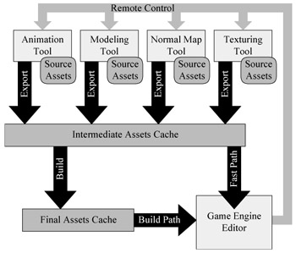
The Game Asset Pipeline
From the end-user perspective, the asset pipeline should be transparent. In fact, the ultimate reward for the developer of the asset pipeline occurs when artists and game designers do not know about the existence of the pipeline and feel there is nothing in between their creation tools and the game engine.
The most important piece of the asset pipeline from the user's point of view is the game engine editor. It is the tool that provides the asset integration interface into the game engine. The editor is built on top of the same engine core technology as the game itself and provides artists, designers, and engineers the necessary WYSIWYG (What You See Is What You Get) environment for putting together the assets and addressing design or engine issues rapidly.
The two main concerns when designing a content pipeline are efficiency and flexibility [17]. Efficiency is required in order for the team building the game to be able to deliver great content on time, and flexibility is required to be able to adapt the pipeline to the evolving needs of the team. Unfortunately, these two priorities are somewhat in opposition to each other, so there isn't a single solution that can satisfy all projects. Instead, a choice of compromises defining the requirements for the design of the asset pipeline is needed.
Therefore, the game engine editor will offer a combination of view-only and editing capabilities based on the specifics of a project. The question is where to draw the line
The other main point to consider is robustness. The asset pipeline is the backbone of the project and the team. The project is at a standstill when the pipeline is broken, and everyone on the team is idling while they wait for the pipeline to be fixed. A solid design and the proper documentation telling a team how to use and extend the asset pipeline is the key to its robustness.

Slide 58

Obrigado

